Slide 1
Arrow Function and Callback
Arrow Functions
Callback
Event Loop with Callbacks

Slide 2
Arrow Function
Arrow functions are a more concise syntax for writing function expressions. They utilize a token, => , that looks like a fat arrow.
Basic syntax of arrow function:
(param1, param2, paramN) => expression

Slide 3
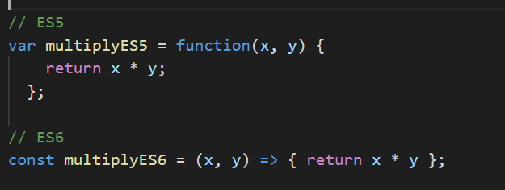
Arrow Function Example

Slide 4
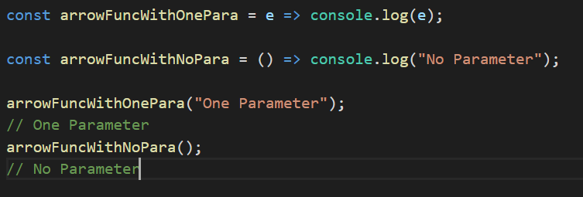
More Arrow Function Examples

Slide 5
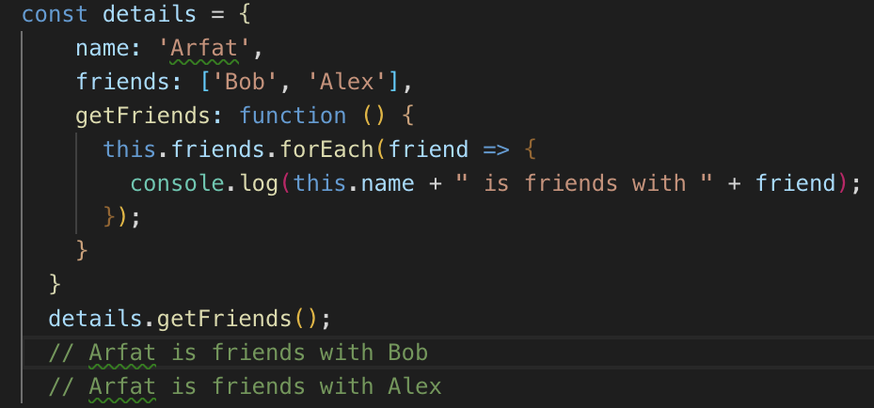
No Binding of This
Arrow functions always have a value of "this" keyword taken from the parent scope. That is, they don’t have any intrinsic, own this value.

Slide 6
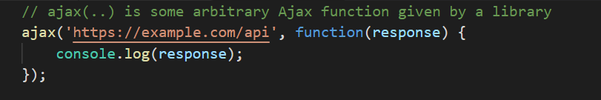
Callback Functions
Standard Ajax requests don’t complete synchronously, which means that at the time of code execution the ajax(..) function does not yet have any value to return back to be assigned to a response variable.
A simple way of “waiting” for an asynchronous function to return its result is to use a function called callback, like in the follow example:
or more simply by using arrow function:

Slide 7
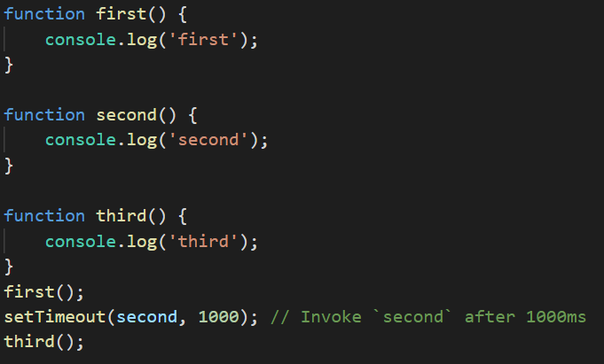
A Callback Example with Function setTimeout

Slide 8
The Event Loop (1)
JavaScript itself has actually never had any direct notion of asynchrony built into it. The JavaScript engine has never done anything more than executing a single chunk of your program at any given moment.
So, who tells the JS Engine to execute chunks of your program? In reality, the JS Engine doesn’t run in isolation — it runs inside a hosting environment, which for most developers is the typical web browser or Node.js. The common denominator in all environments is a built-in mechanism called the event loop, which handles the execution of multiple chunks of your program over time, each time invoking the JS Engine.

Slide 9
The Event Loop (2)
JavaScript is a single-threaded programming language, which means it has a single Call Stack. Therefore it can do one thing at a time.
The Call Stack is a data structure which records basically where in the program we are. If we step into a function, we put it on the top of the stack. If we return from a function, we pop off the top of the stack. That’s all the stack can do.
The Event Loop has one simple job — to monitor the Call Stack and the Callback Queue. If the Call Stack is empty, it will take the first event from the queue and will push it to the Call Stack, which effectively runs it.

Slide 10
The Event Loop (3)
So, for example, when an Ajax request to fetch some data from the server, the “response” code is set up in a function (the “callback”), and the JS Engine tells the hosting environment: “Hey, I’m going to suspend execution for now, but whenever you finish with that network request, and you have some data, please call this function back.”
The browser is then set up to listen for the response from the network, and when it has something to return to you, it will schedule the callback function to be executed by inserting it into the event loop.

Slide 11
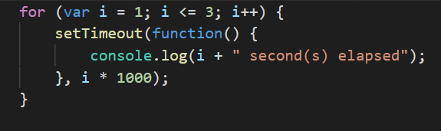
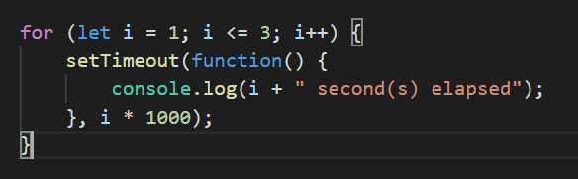
Scope Issues with Callbacks Inside Loops
A callback inside of a for-loop might encounter some unexpected behavior. Think about what you would expect the following two codes below to do:

Slide 12
Explanation of scope issue
The key to this example is the difference in scope of the looping index variable “i”
var “i” sets the scope of the variable to be global or a least to the function
let “i” sets the scope of the variable to the block (inside the loop).
The first iteration of the “var” loop calls the setTimeout function and the callback function utilises the value of “i” as it is set at the time it gets called back. In this case all iteration of the loop complete before the first of the callbacks are returned. At this time the global value of “i” is 4 and all callbacks come back the same.
When using the “let” block scope the values return as expected as 1,2,3.

